Slide 1
Computational Thinking Session 1 Coding for Reproducible Research
October 2025

Slide 2



Why bother with this content?
Problem Analysis
Design Solutions
Agnostic to any code
Notes:
Why bother with this content?
We are going to step back from programming and consider how we go about designing a programming solution.
What we will cover is agnostic of any specific programming language and is a transferable set of skills that will help you develop as a programmer.

Slide 3

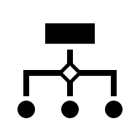

What is computational thinking?
Writing Commands
Designing
Ideas
Notes:
When we program, we write a series of commands in a language that our computer understands. We use a combination of functions and syntax to instruct the computer to enact a series of commands. When you sit down to program there is an assumption that you already know:
1. What you want the computer to do
2. How it should do it
This part, the design of what the program/code does, is where computational thinking comes in.

Slide 4
Activity: Defining Computational Thinking
My experience:
Has anyone used pseudocode before?
Rubber duck programming?
In groups, discuss what computational thinking means to you?
Do you have prior experience in this area (particularly if its not programming related!), what are your strengths?

Slide 5



The process of computational thinking
Complex Problem
Problem Understanding
Solution Development
Notes:
Computational thinking allows us to:
Take a complex problem
Understand what the problem is
Develop possible solutions that we could instruct a computer to implement

Slide 6



Is this not covered when I learn to code?
Code and Syntax
Goal Definition
Logical Planning
Computational Thinking
Notes:
Thinking computationally differs from coding or computer programming in that a program tells a computer what to do.
Computational thinking enables you to work out precisely what to tell the computer to do
It is a mental task to solve the problem in front of you.
These are two separate skills and two separate tasks.
When we learn to code, we are primarily focused on content related to the specific command names and relevant syntax.
Sometimes, this skill is included in introductory programming workshops, but when it is, it is often not explicit.

Slide 7




Learning which tool to use, not new tools
Syntax Practice
False Confidence
Tool Selection
Decision Process
Notes:
Learners are often taught common programming constructs like for loops or if-else statements, including how to write and execute them.
They are shown examples and encouraged to write and run specific cases using constructs like for loops.
While this builds confidence in implementing the constructs, it may not equip learners to identify when a for loop is more appropriate than other constructs for a given problem.
An analogy can be made with the teaching of statistics, where individuals learn how to perform specific tests (e.g., t-tests) and practice them.
While they can execute these tests if instructed, they may lack the ability to determine when a t-test is more suitable than alternatives like regression analysis.
The focus often lies on teaching how to use tools rather than how to choose the right tools for a problem.

Slide 8



Why is this a problem?
Simple tasks
Complex tasks
Pause to Plan
Debugging Ambiguity
Notes:
For simple tasks:
Solving and implementing the problem can happen simultaneously.
There is no harm in not distinguishing these tasks.
For more complicated tasks:
Computational thinking may come naturally to some people, enabling them to solve and implement instinctively.
However, most people encounter difficulties when this combined approach becomes problematic.
Consequences of not separating problem-solving from implementation:
You may not realize that you are performing both tasks simultaneously when writing new code.
Writing code requires knowing what you want the code to do beforehand.
Pausing while writing code (e.g., hovering over the keyboard) often reflects time spent thinking through the solution.
Challenges of not distinguishing the tasks:
Debugging becomes more difficult as it is hard to identify whether:
The problem lies in the code (e.g., syntax errors).
The problem lies in the solution being implemented (e.g. logic error).
The computer always executes instructions as given:
If the behavior is unexpected or undesired, it likely stems from asking the computer to do the wrong thing.

Slide 9



Where this workshop comes in:
Algorithm design
Forethought and Planning
Building
Solution Construction Errors
Notes:
The goal of this workshop is to step back from coding and focus on the design of algorithms.
Our intention is to encourage you to code with more forethought
Furthermore, understand which errors relate to:
Constructions of the code
Construction of the solution

Slide 10
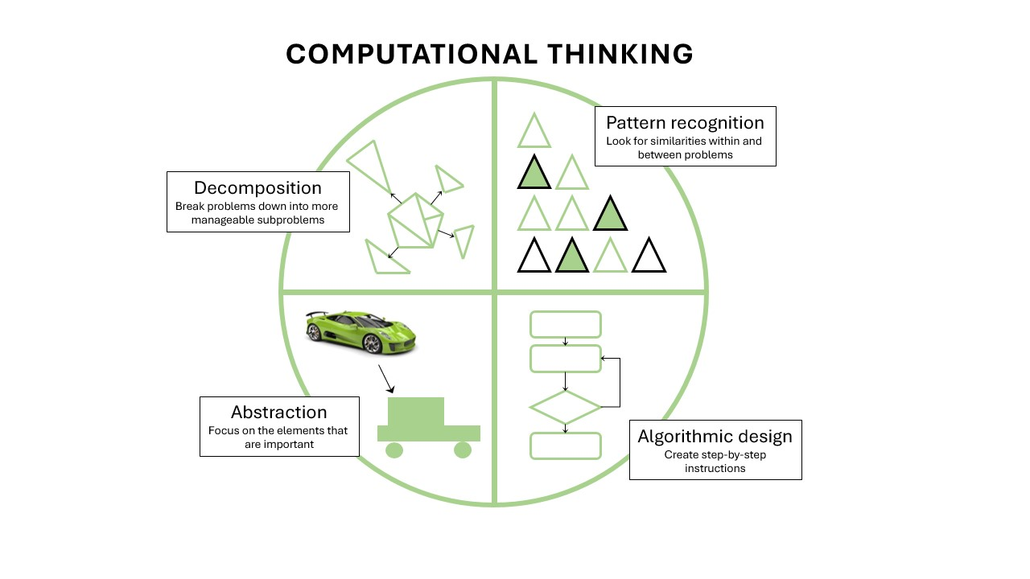
The four key steps of computational thinking

Slide 11
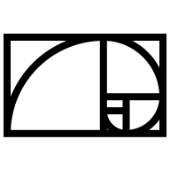

By the end of this workshop
Algorithm Definition
Decomposition
Pattern Recognition
Abstraction
Notes:
At the end of the workshop, you will be able to:​
- define what an algorithm is​
- design an algorithm by implementing the following techniques:​
decomposition - break a complex task into smaller units​
pattern recognition - identify repetitive elements in your task that can be automated​
abstraction - focus in on the essential components needed to complete the task​
​

Slide 12


The main take away…
Then
Think
Code
Notes:
Think before you code

Slide 13
Activity: What do you do before coding?

Slide 14


Program or algorithm?
Algorithm
Informs
Program
Notes:
A program is a sequence of instructions that tells the computer todo something. ​
- An algorithm is a sequence of steps that solve a specific problem ​
- They differ from each other in that an algorithm will solve the problem,while a program implements an algorithm in a form that a computer canexecute. ​
- All computer programs are based on algorithms ​

Slide 15


Algorithms
Used everyday
Range of complexity
Notes:
- Although algorithms are generally thought of as complicatedthings used by programmers,​
- People use them everyday to complete tasks​
- Ranging from incredibly simple to incredibly complex​

Slide 16

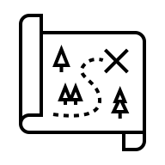

Example Algorithms
Recipe = Algorithms for Meals
Direction = Algorithms for Navigation
Reading a Clock = Algorithms for Time
Notes:
- Examples: ​
- A recipe is an algorithm designed to assemble certain elements into ameal ​- Algorithm for meals
- Directions to navigate a person from A to B ​
- How to read a clock​

Slide 17





Benefits of algorithms
Reproducibility
Efficiency
Scalability
Sharable
Automation
Notes:
- Algorithms are essential tools but they are also really powerful​
- Apart for the purposes of programming, they have advantages as: ​
- Reproducibility - a standardized process ensures the same steps on everyexecution​
- Efficiency - identify repetitive processes and optimize, removeunnecessary steps​
- Scalability - a clearly defined process can be extended to run on largerdatasets​
- Sharable - efficient way to share a process with others​
- Automation - once a repeatable solution has be defined it can beautomated​

Slide 18
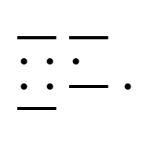



Faulty Design vs Faulty Implementation
Programming Efficiency = More than code
Problem Solving and Translation to the computer
Writing code others understand
Algorithm vs Program Errors
Notes:
-Being an efficient programmer is not only about writing code that does something ​
-It is about solving problem in a way that is translatable to a computer​
-And sometimes also key to be able to design code that is easily understood byother programmers​
-Commonly, what people think of as a problem with code writing is infact a problem with the algorithm. ​
-In the real world example before (recipes and directions), we haveprobably experienced a time when they go wrong. ​
-These are good examples of how to demonstrate the distinctionbetween errors in the algorithm compared to errors in how it istranscribed into instructions.​

Slide 19
The example of directions
Lets say you’ve arrived in London at Paddington train station and you need to go to Edgware. ​
A friend has helpfully written down the route by the underground.​
The algorithm you have is:​
Get on the Hammersmith and City, Circle or District line ​
Ride one stop ​
You follow these instructions and when you get off the tube, the sign at the station says Edgware Road. That’s not the right destination ​
You call your friend. Their response is "Oh I thought you wanted to get to EdgwareROAD not Edgware". ​
This isn't a problem with the instructions (i.e. the code) the problem is the algorithmhad the wrong destination in mind when designing it. ​
The instructions to get to the incorrect destination were correct and you followed them as planned ​

Slide 20
Corrected: The example of directions
Now clear, on your required final destination, your friend now gives yousome new directions. You write the down and follow them: ​
Get on Hammersmith and City or Circle line ​
Ride four stops to Kings Cross​
Change to Northbound Northern Line ​
Ride to end of line ​
Again you get out at your final destination, where the sign says HighBarnet. ​
The wrong location again! You call your friend, she runs through theinstructions with you again and you compare to your written notes. ​
This time you incorrectly wrote the instructions down. In this instancethe problem was a coding error, the algorithm was fine, but you had anerror in the set of instructions you used to navigate.​

Slide 21



“Bugs” or coding errors
Coding Errors = Easier to Detect
Text Editor Support
Algorithm Errors = Harder to Detect
Predicting and Evaluating (Debugging Algorithms)
Notes:
- Typically coding errors are easier to detect and fix, than problemswith the underlying algorithm. ​
- A good text editor with syntax and language highlight can preventthese. ​
- To pick up issues with the algorithm, requires more manual work,typically working through the algorithm and compare what thecode is actually doing compared to what you thought it should bedoing. ​
- This uses a combination of predicting and evaluation to debug yourcode.​

Slide 22
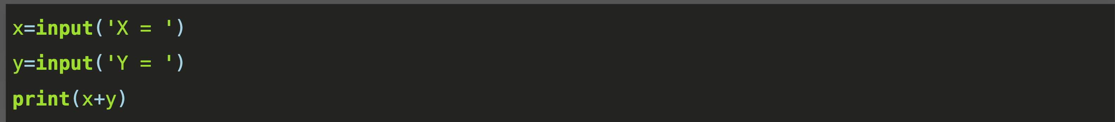
Activity: Addition
We have created a program that asks a user for x and y values and then returns the sum of them
You can type this program using this online console:
https://tio.run/#python3
Type the three lines of the program into the ‘Code’ box

Slide 23
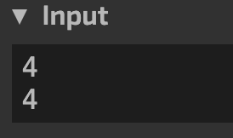
Activity: Addition
Type your numeric input into the ’Input’ box as shown below:

Slide 24
Activity: Addition
Was the output as you expected?
To help decipher why it went wrong try setting ‘computational’ and ‘thinking’ as your input for X and Y
Clue type()

Slide 25
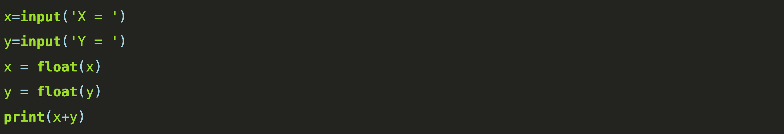
Activity: Addition
The problem here is that the code is not accepting the input as numeric values, it is treating them as text strings.
Our algorithm is missing a critical step where it converts the text input into numeric values. The correct algorithm would be:
Often what we think are issues with implementation are actually issues of algorithms.
The claim there is something wrong with my code/script infers that the problem is syntax, when more likely the problem is with what you are asking the code to do.
This phrasing can be misleading as it fails to recognize the two possible sources of errors.

Slide 26
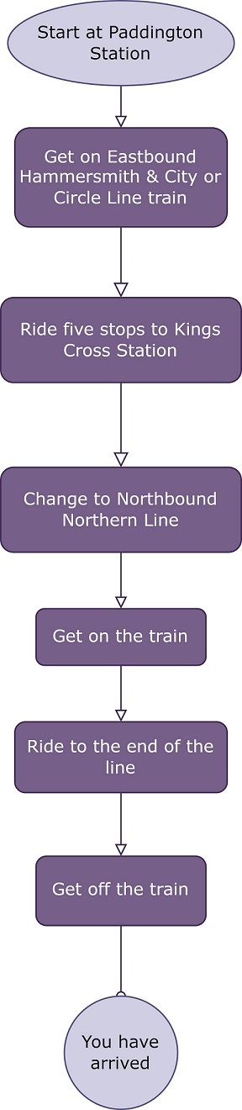
Designing an Algorithm
Notes:
A simple way to represent an algorithm can be through a flowchart.
This can be a useful tool for visualizing and designing an algorithm.
The flowchart to the right represents instructions for directing someone from Paddington Station to Edgware on the Underground.

Slide 27
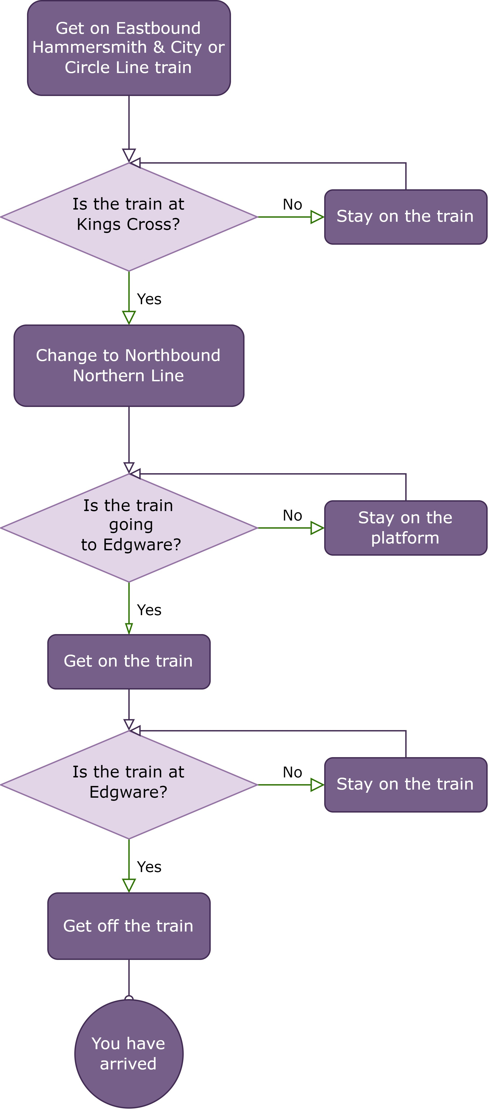
Notes:
The previous example was quite simple, with sequential steps.
You can think of this algorithm as a series of instructions
Alternatively the steps in the algorithms might need to be decision or rules.
In this instance we need to use logic or define conditional criteria which determine the pathway through the algorithm.
We can solve the same problem using a more complex flowchart that includes some decision making changes.

Slide 28
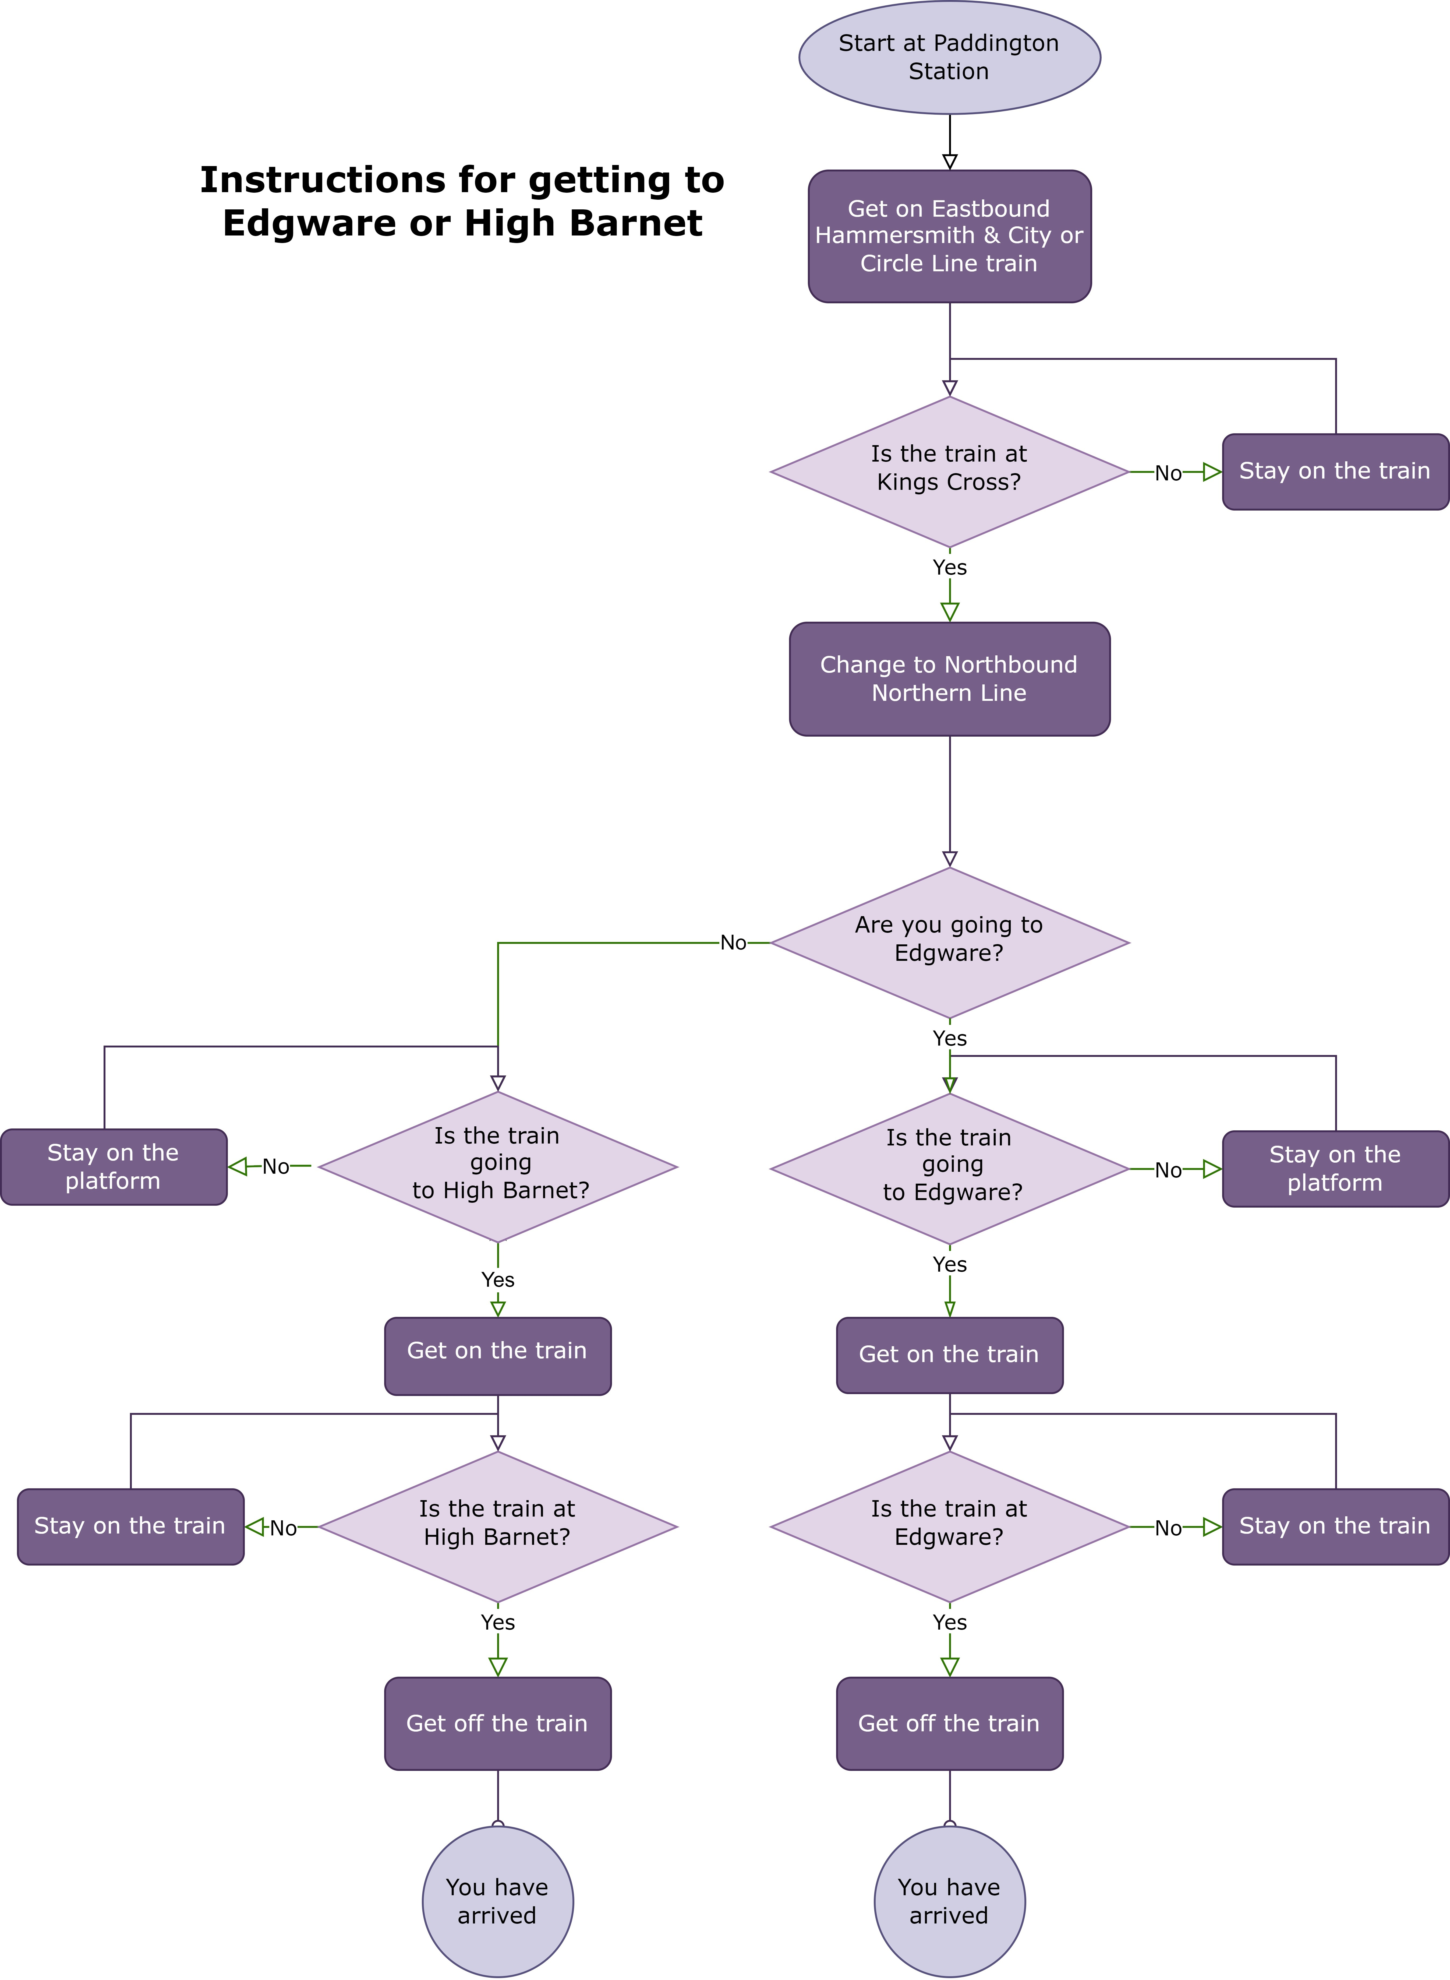
Notes:
Most algorithms, especially complex ones, will need both components.
When you think about your algorithm as a series of steps, it become easy to see how you could extend it to solve more problems, or to make it more generalizable.
For example, here is a single algorithm to navigate from Paddington to two different destinations.
Hopefully you now appreciate you can design multipale algorithms to solve the problem

Slide 29
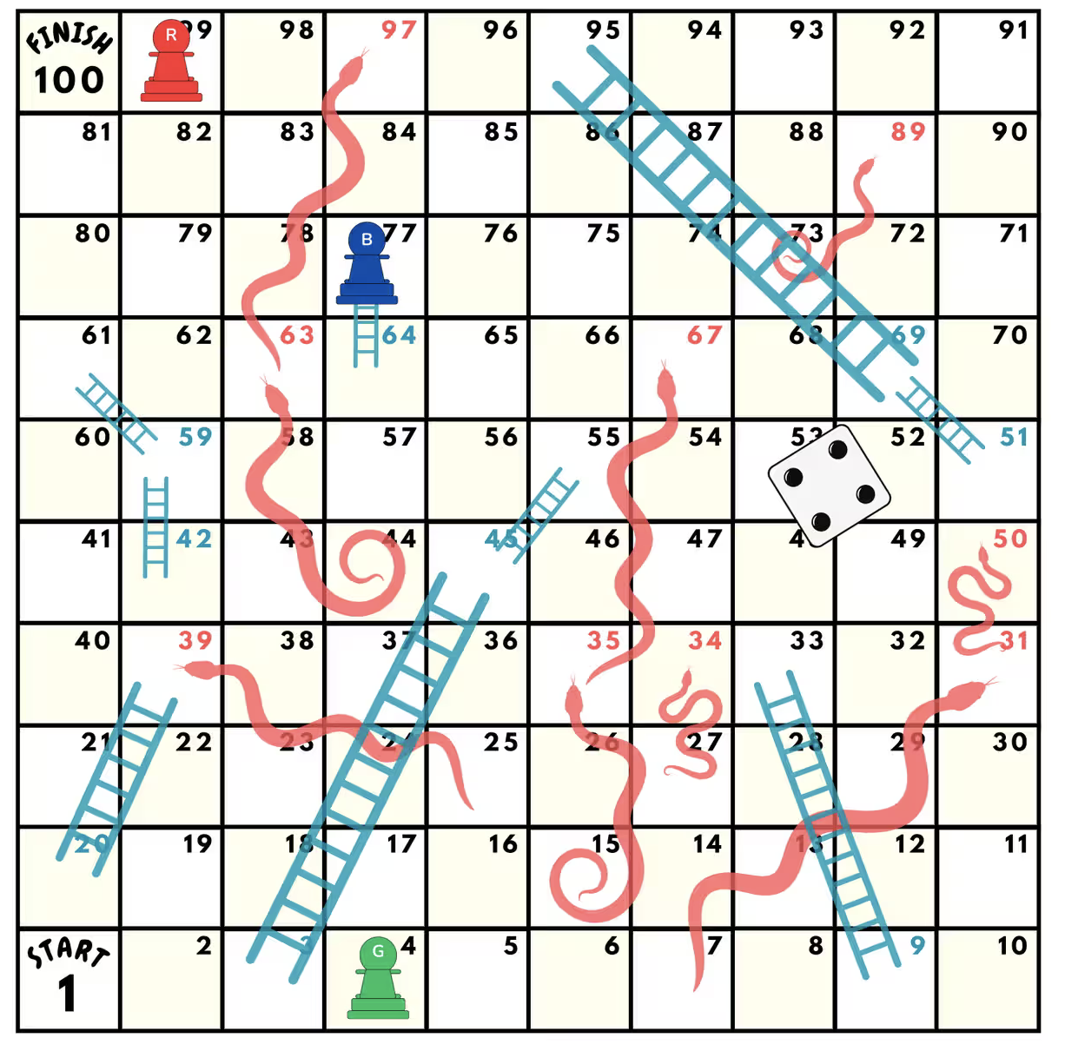
Activity: Snakes, ladders and flowcharts
Snakes and ladders is a dice game where players advance along the board based on the roll of the dice.
Upon landing on a square on the board, a play may either encounter
a snake, where they are forced backwards a number of squares,
a ladder, where they advance a number of square, or
nothing, in which case they remain on that square.
A play wins when they reach the end of the board.

Slide 30
Activity: Snakes and ladders and flowcharts
Design a flowchart for the game, where:
The max number of squares is 100
And the maximum number of squares a player is advanced or returned should be 30.
You can create this digitally at draw.io

Slide 31


Techniques for Designing
Decomposition
Pattern Recognition
Abstraction
Notes:
When designing an algorithm there are techniques we can use to aid us in the design of the solution to our problem and design of our algorithm:
decomposition
pattern recognition
abstraction
You may have implemented some of these already in the previous activity. We are going to cover each of these in the following sections.

Slide 32

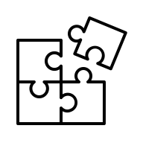
Decomposition
Break Down
Put Together
Integrate
Notes:
Decomposition refers to the process of breaking down a complex problem into smaller, simpler sub-problems.
The idea is to solve each subproblem independently and then combine the solutions to obtain a solution to the original problem.
This allows for the creation of more efficient and manageable algorithm by reducing the complexity of the problem and making it easier to identify and solve individual parts.
Equally, this makes your code more reusable as each function solves a smaller issue which may be reusable elsewhere.
E.g. You might make instructions to get to Paddington from Waterloo, that can be used in a number of different directions to smaller individual stations

Slide 33





Actionable Steps
Start Points
Inputs
Initial Conditions
End Point
Result
Target
Notes:
When breaking the problem down it can be helpful to identify
Starting point
What inputs do you have
What are the initial conditions
End Point
What output would you ultimately want
What is the end goal
You can then begin to start to fill in the gaps in between.
Through the process of building your algorithm, you may find that your start point isn’t actually the start point; you need to go further back in the process.
Similar the end goal might be redefined.

Slide 34





The incorrect starting point
Incorrect Starting Point
Missing Step
Complete Steps
Blank Slate
Notes:
For example, in our tube navigation example crucially we are starting at Paddington TUBE Station,
but our passenger is at Paddington RAIL station.
Our algorithm is meaningless if they can’t get to the TUBE station, so we need to add an additional step to navigate from the TRAIN station to the TUBE station.
It is important to remember that your computer knows absolutely nothing at the beginning of a new program - you need to tell it everything.

Slide 35
Activity: Caesar Cypher
In cryptography, a Caesar cipher is a very simple encryption technique in which each letter in the plain text is replaced by a letter some fixed number of positions down the alphabet.
For example, with a shift of 3, A would be replaced by D, B would become E, and so on.
The method is named after Julius Caesar, who used it to communicate with his generals. ROT-13 ("rotate by 13 places") is a widely used example of a Caesar cipher where the shift is 13.
Your task in this exercise is to design the algorithm that a computer would need to follow to encode/decode a message using ROT-13. How does the idea of decomposition apply here? What would you do to implement this?
It might be helpful to think through how you would manually decode the following message:
Additionally, why was ROT-13 common in the Caesar Cypher?
CLUE: Try performing the encryption twice on ‘HELLO’

Slide 36

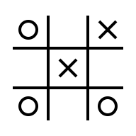


Pattern Recognition
Spot Patterns
Reuse Patterns
Recognise Signatures
Repeat Sequence
Notes:
Pattern recognition involves finding the similarities or patterns among small, decomposed problems that can help us solve complex problems more efficiently.
Once a problem has been broken down into simpler sub-problems, there may be similarities among these that mean we do not have to write a solution twice.
These problems may exist both between and within individual problems.

Slide 37
Pattern Recognition Example
Sometimes the redundancy can be simple to spot
For example, let 's say we want to calculate the first 5 square numbers. This involved five sums:
1*1
2*2
3*3
4*4
5*5
For each number we are doing the same thing: multiplying it by itself. We can easily take advantage of that fact to write a function, or use a for loop or similar construct

Slide 38
Pattern Recognition Example 2
Sometimes it’s a little harder to define a pattern
For example, lets say we want to calculate the first 5 triangular numbers:
1
1+2
1+2+3
1+2+3+4
1+2+3+4+5
We can see a pattern here but it's not as simple as the square number example.
It is a pattern of two stages: first we need to create a list or sequence of the numbers, before we can sum them.
Now that we have identified the pattern, we can try to construct some code to automate/simplify its implementation.

Slide 39
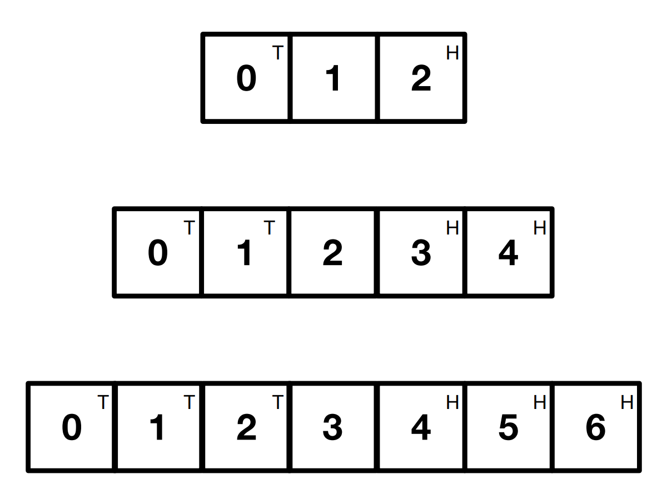
Activity: The swap puzzle
Place small coins heads up on the squares marked H and tails up on the squares marked T. Swap the positions of the Heads for the Tails in as few moves as possible.
There are two ways to move a piece:
Move left or right to an adjacent empty square
Jump over a single adjacent piece into an empty space.
There are three increasingly larger boards that get harder. Complete the first in 3 moves, the second in 8 moves and the third in 15 moves.
Can you identify the pattern for a general solution for each board?

Slide 40
Computational Thinking Session 2 Coding for Reproducible Research
October 2025

Slide 41
The four key steps of computational thinking

Slide 42




Abstraction
Filter Details
Hide Layers
Black Box
Mask Complexity
Notes:
Abstraction is about simplifying problems, making them easier to solve. The idea is to identify and then ignore information that is not essential.
Relation to programming:
Abstraction is an approach that helps solve problems.
A core component of programming is about creating and composing abstraction, using objects and functions to represent and define the solution.
Abstraction works by establishing a level of complexity at which a person interacts with a system, suppressing the more complex details below the current level.
Abstraction allows programmers to define objects and functions that can interact with each other in a predictable way without having to understand the underlying details of their implementation.
When you see a simple interface covering a more complex implementation, this is abstraction.

Slide 43
Example – the London tube map
The problem the tube map is designed to solve is to help people navigate the underground system in London. The essential information to complete this task is:
The name of each station
Which lines each station is on
The order of the stations on each line
Which station are intersections between lines
Which stations have onward connections to other transport modes (e.g. National Rail)
Which station have step free access

Slide 44
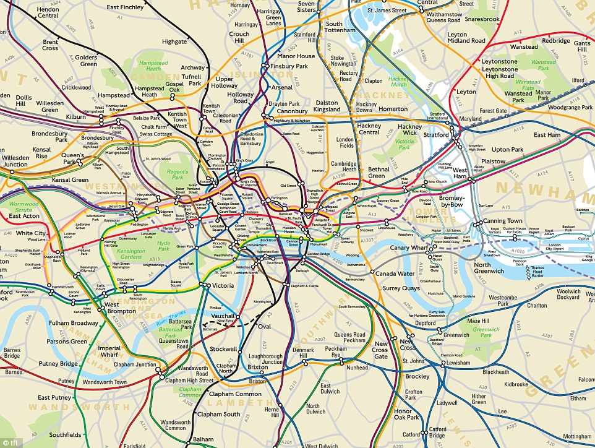
The precise location of each station and its surroundings isn’t important

Slide 45
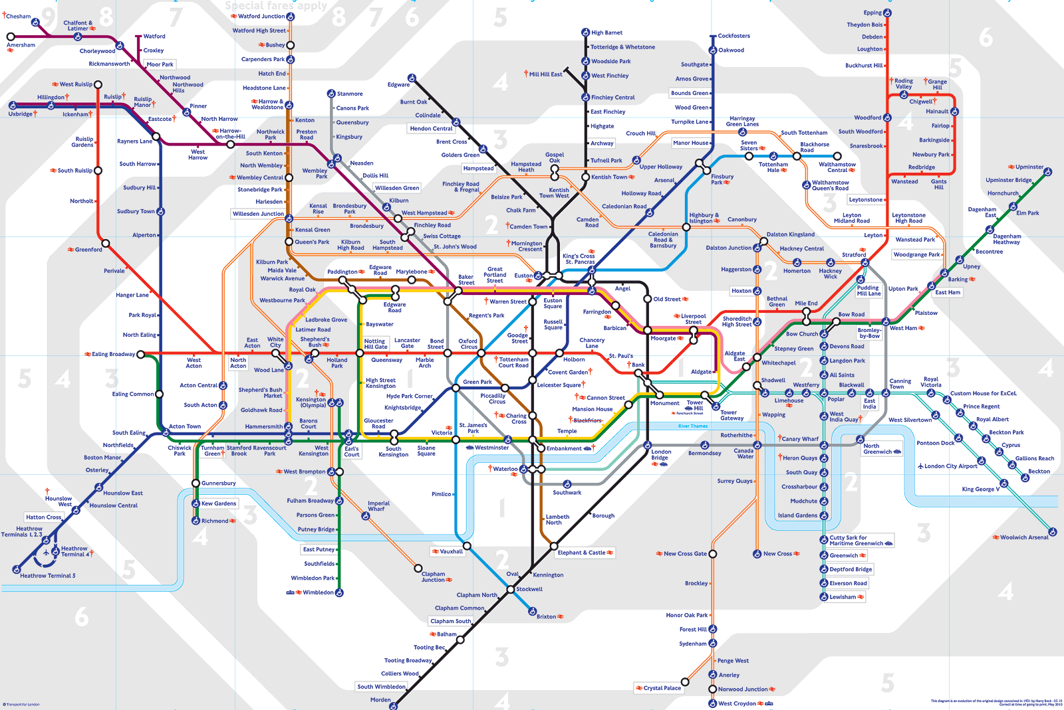
So it is abstracted away

Slide 46
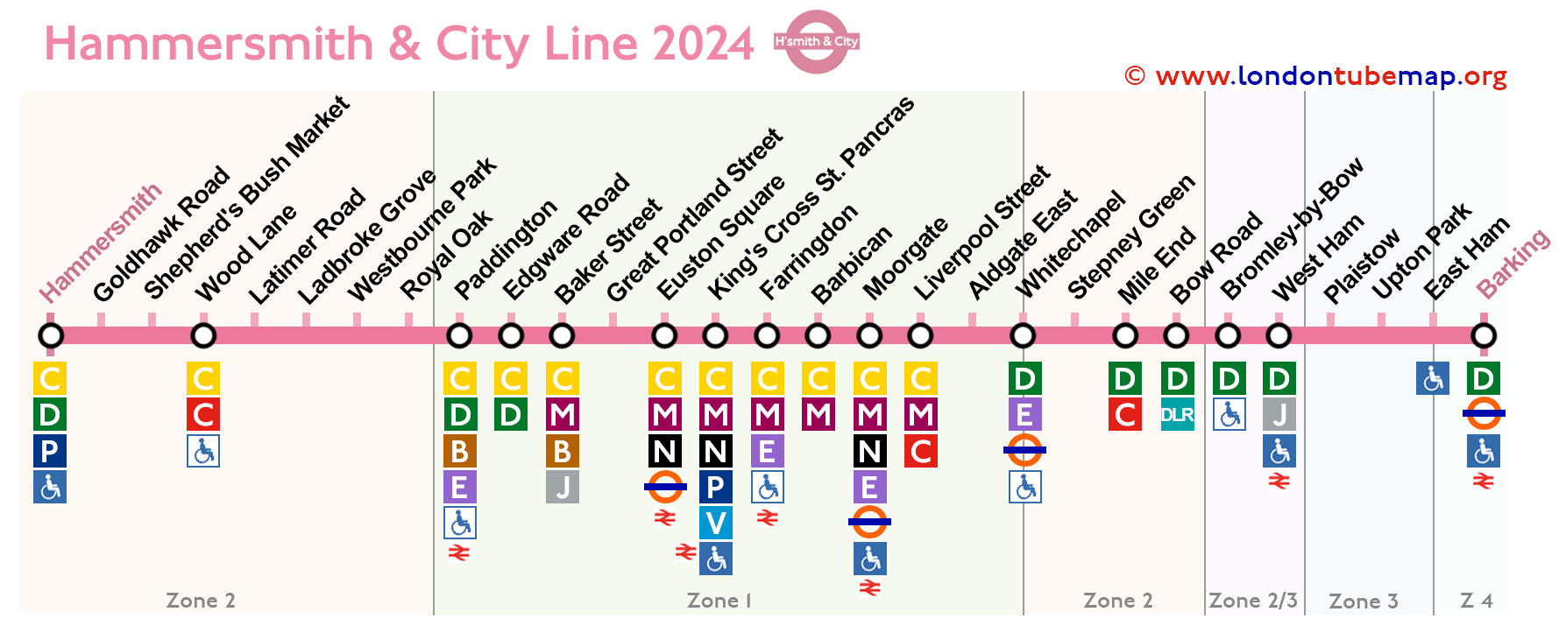
With even less when a single line is shown

Slide 47





Example – Motorcar
Car as the interface
Controls
Hidden Complexity
Learn the effect, not the mechanism
Notes:
The interface of a car is simple:
Steering wheel
Accelerator
Brake
Gear stick
However these cover a much more complex machine.
You learn that pressing the accelerator makes the car go faster but you are not taught how the acceleration actually works - because the details fo this are not important for you to drive this car.

Slide 48
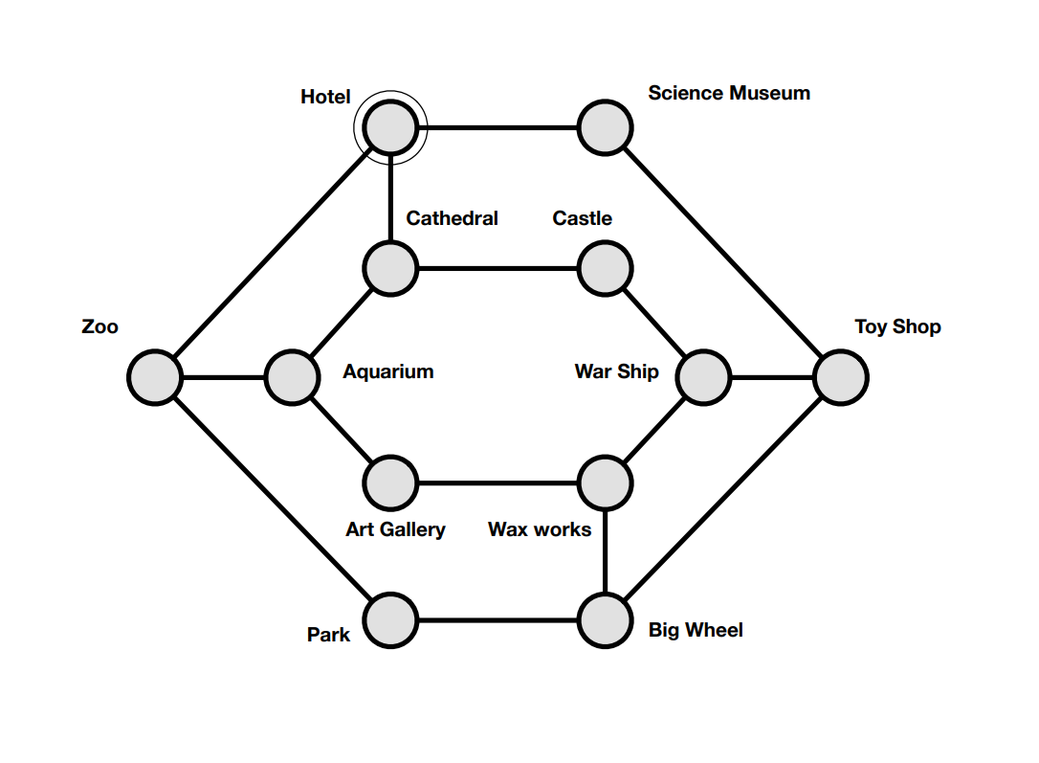
Activity: Tour Guide
You are a hotel tour guide. Tourists staying in your hotel expect to be taken on a tour visiting all the city’s attractions. Using this map showing locations of all the attractions, and how to get from one to another, you must work out a route that starts from the hotel and takes your tour group to every tourist site.
Tourists will be unhappy if they pass through the same place twice
They must end up back at their hotel that evening
How would you solve this? What is the minimal amount of information you need to extract from the map to solve it?

Slide 49
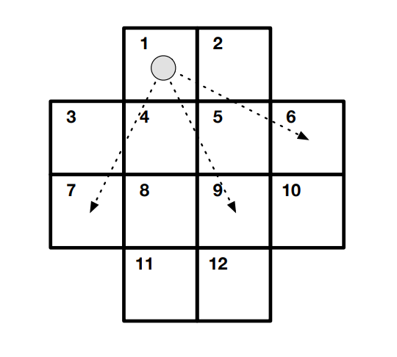
Activity: Knights Tour
On the cross shaped board below, a chess Knight can move two spaces in one direction and then move one square at right angles, or vice versa, as it moves in a chess game.
It jumps to the new square without visiting any in between, and must always land on a square on the board.
Find a sequence of moves that starts from Square 1, visits every square exactly once and finishes where it started.

Slide 50



Similar Problems?
Network Graph
Adjacency Grid
Smart Traverse
Notes:
Are these problems similar?
How might you represent the knights tour in a different way to simplify finding a solution?
Abstraction can be incredibly powerful. In the face of a complex problem, the ability to separate what aspects of a problem are important for solving it, and what are spurious details really helps to design a computational solution.
Abstraction not only makes a problem easier to solve, it should also lead to a more efficient solution as you are not spending time processing information that does not help you get to the solution.

Slide 51


Aligning the human solution with the computer
Human Solution
Translation to Code
Alignment Step
Notes:
- So far, we have covered the four pillars of computational thinking:​
- Algorithms​
- Decomposition​
- Pattern recognition​
- Abstraction​
- These approaches have allowed us to develop a solution to our problem. ​
- Critically at this stage it is likely that the solution will look like a human solution. ​
- We are now going to focus on translating this solution into something we can write code for. ​
- To do this we need to align this human solution to concepts, constructs or paradigms for our language of choice.​
- Whilst computational thinking is agnostic of programming language, this translation element may vary depending on the specific language. There are however some common themes we can identify.​
​

Slide 52

Deciding on the language to use
Choosing the best-fit language
Foundational Blocks
Functions = Processes/Actions
Objects = Variables
Abstraction
Notes:
DecisiIf you have knowledge of different coding languages or styles, with yoursolution in hand you are now in a position to evaluate which of thosemight be the best fit.​
The foundational blocks of most programming languages are objects andfunctions.​
Objects are the basis of variables you define or declare.​
Functions are processes or actions you perform (often to objects but notalways). When we talk about aligning our human solution to one acomputer understands, we need to reframe it in terms of variables andfunctions (or the processes underlying those functions).​
The most relevant approach here is abstraction. We need to identifywhich information our program needs to know in order progress throughthe workflow.​
​

Slide 53
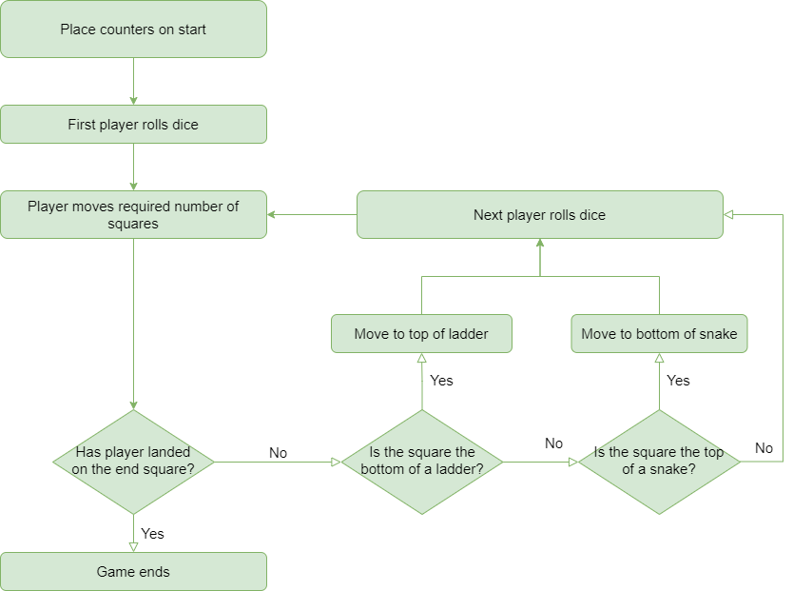
The human solution to Snakes and Ladder

Slide 54
The number of players
The key point of the game is the movement of players around the board.
Therefore, the computer needs to always know where the players are located.
Using abstraction: the one piece of information we need is the number of the square that the player is on at that time in the game.
We could store this as a variable for each player, e.g. P1, P2, P3
But then we also need to know how many players are in the game, e.g. 2 or 6
If we get this wrong we might have redundant data that wastes memory, or we dont have enough
Therefore we should abstract again to a data structure, called P to store some number of positions, from P1,…,PN

Slide 55
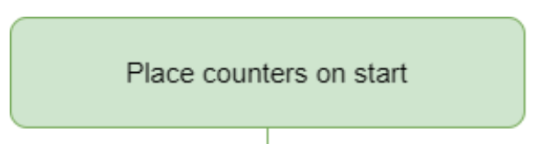
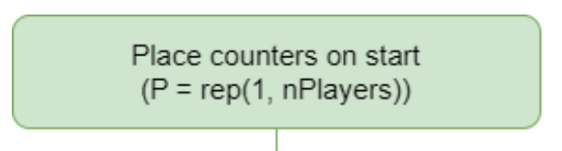
Where do players start?
The next question is, then, what values do these start as?
All of these values will therefore start as 1, the first square.
As such, we could rewrite the first part of the flow chart with additional details to be:

Slide 56
Activity: Additional Details to the snakes and ladders flowchart (this is complex, so don’t worry about getting it “right”!)

Slide 57
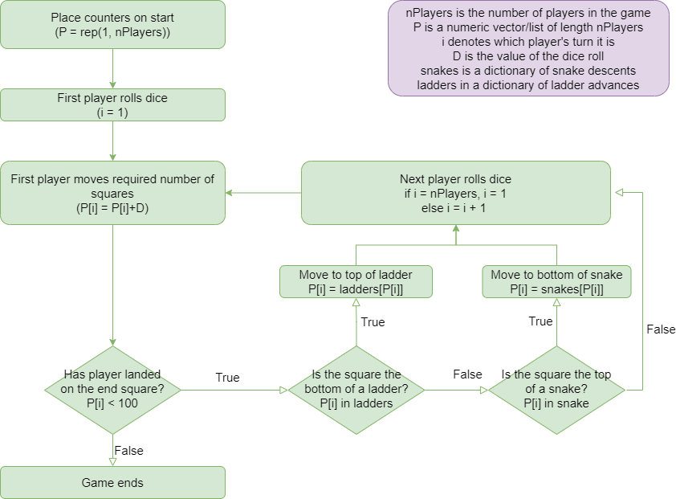
A complete walkthrough of the solution is available on the CfRR website:
https://coding-for-reproducible-research.github.io/CfRR_Courses/individual_modules/computational_thinking/alignment.html

Slide 58
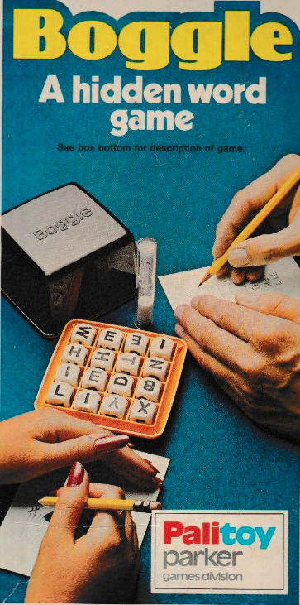
Activity: Boggle
Putting everything together to design a software model of a popular game, Boggle!
Equipment
The equipment includes a sixteen letter cubes, a shaker-tray and a timer (I have two examples to show!)
Object
The object is to list, within the time limit, as many correct words as possible. Words are formed from the assortment of letter arranged in the cube tray, when they are adjacent to each other.

Slide 59
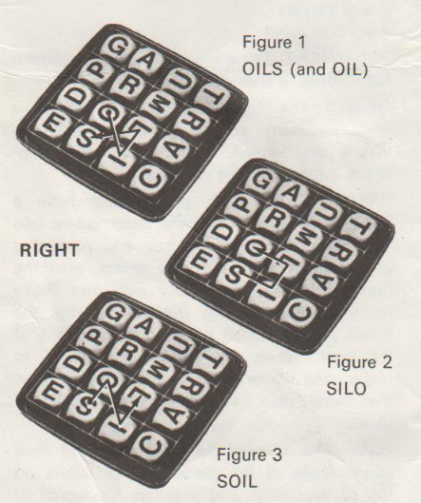
Rules
Words are formed by the use of adjoining letters. Letters must join in the proper sequence to spell a word. They may join horizontally, vertically or diagonally, to the left, right or up and down. But no one letter cube may be used more than once within a single word.

Slide 60
Software Design Exercise
Use computational thinking techniques to understand the characteristics of the Boggle game. Use this understanding to design a software system that can generate and solve Boggle puzzles.
You might choose to design your software in a visual style, perhaps as flow charts, or you could write pseudo-code, or an outline in a coding language such as R or Python.
The aim is not to create a working program, but rather to express the key design decisions in a way that can be discussed and shared.

Slide 61
Online Game
https://www.saunby.net/boggle/

